Slide 1








Power Group
ENERGY CONSUMPTION
ANALYSIS
Presented by:
S Ashok Vardhan
S Naga sravani
M Sai Ajay Gowdu

Slide 2



Power Group
Introduction
Energy consumption plays a crucial role in global economic growth and sustainable development.
With increasing population, urbanization, and industrialization, the demand for energy has grown significantly across countries and regions.
This project analyzes worldwide energy consumption data using SQL to understand energy usage patterns, trends across countries, and the contribution of different energy sources.
By storing and querying the data efficiently in a relational database, SQL helps in extracting meaningful insights to support data-driven decisions related to energy planning and sustainability.

Slide 3
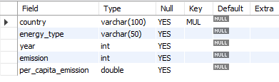

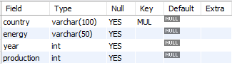
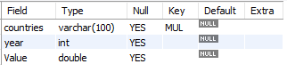
Power Group
Tables
Emission Table
Country Table
Production Table
Population Table

Slide 4
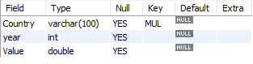
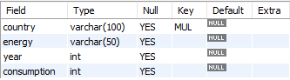
Power Group
Tables
GDP Table
Consumption Table

Slide 5
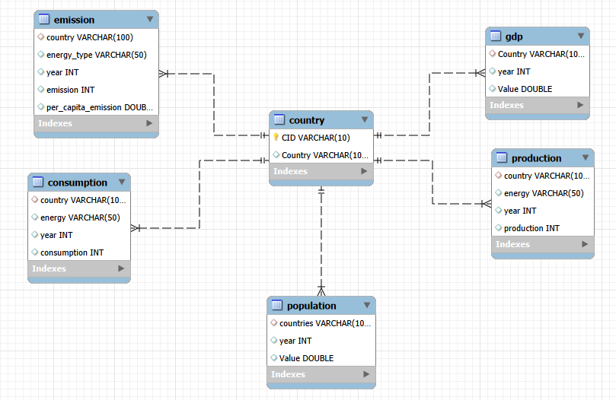

Power Group
ER Diagram

Slide 6

Power Group
Problem Statement
Global energy consumption, economic growth, population expansion, and environmental impact are strongly interconnected. Countries differ significantly in how they produce and consume energy, generate greenhouse gas emissions, and grow their economies over time. Understanding these relationships is essential for sustainable development and policy planning.
The purpose of this SQL project is to design and query a relational database that enables systematic analysis of global emissions, energy production, energy consumption, GDP, and population across countries and years.

Slide 7
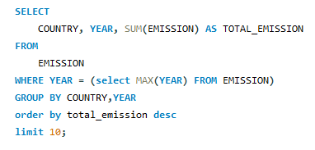
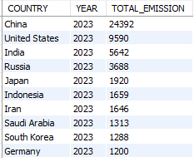

Power Group
General & Comparative Analysis :
What is the total emission per country for the most recent year available?

Slide 8
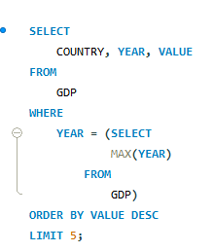
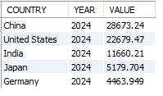

Power Group
2. What are the top 5 countries by GDP in the most recent year?

Slide 9

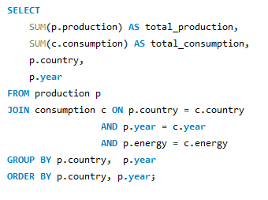
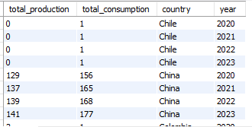
Power Group
3.Compare energy production and consumption by country and year.

Slide 10
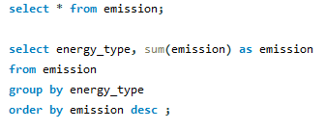
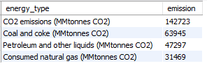

Power Group
4. Which energy types contribute most to emissions across all countries?

Slide 11
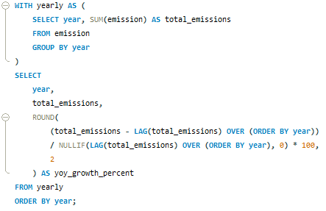
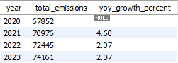
Power Group
5. How have global emissions changed year over year?

Slide 12

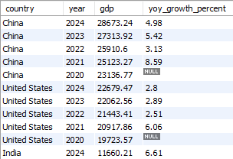

Power Group
6. What is the trend in GDP for each country over the given years?

Slide 13
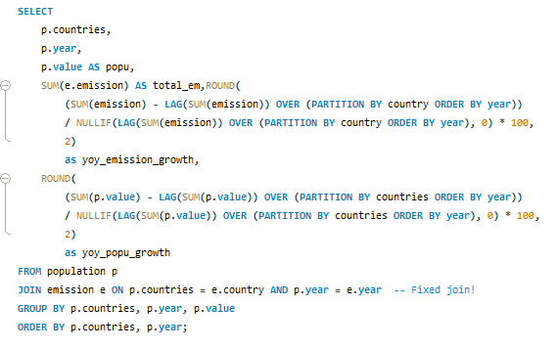
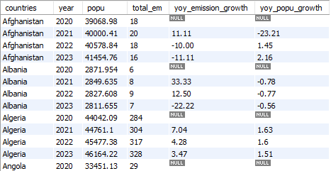

Power Group
7. How has population growth affected total emissions in each country?

Slide 14
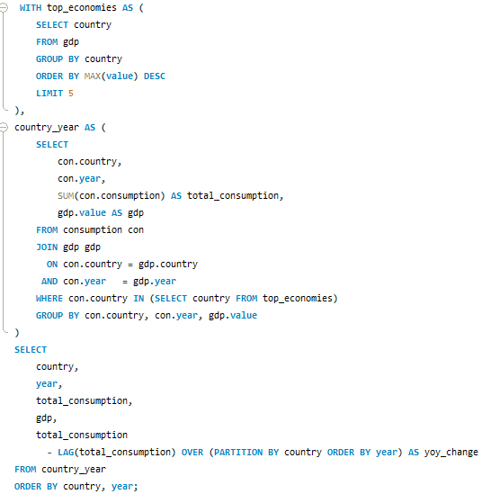
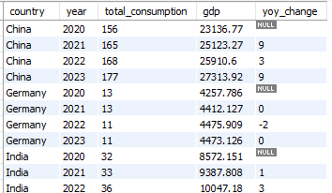

Power Group
8. Has energy consumption increased or decreased over the years for major economies?

Slide 15
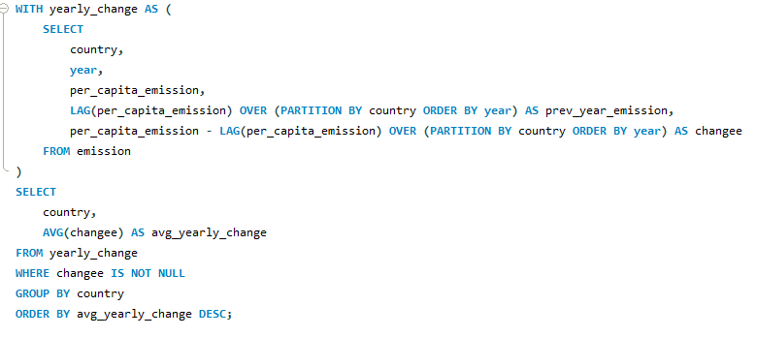
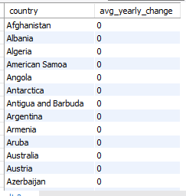

Power Group
9. What is the average yearly change in emissions per capita for each country?

Slide 16
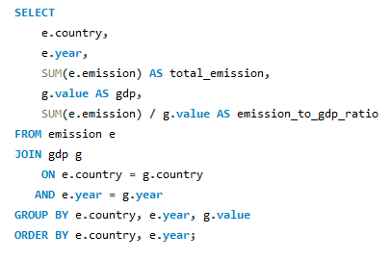
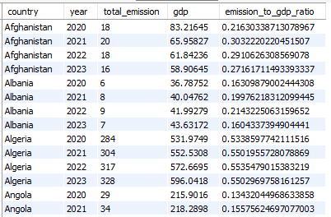
Power Group
Ratio & Per Capita Analysis :
10. What is the emission-to-GDP ratio for each country by year?

Slide 17
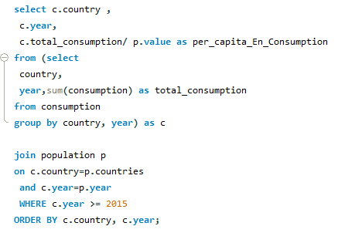

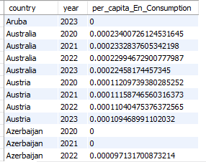
Power Group
11. What is the energy consumption per capita for each country over the last decade?

Slide 18
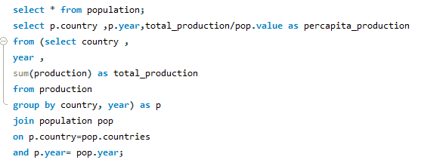
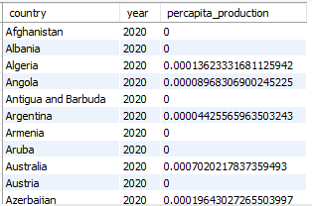

Power Group
12. How does energy production per capita vary across countries?

Slide 19
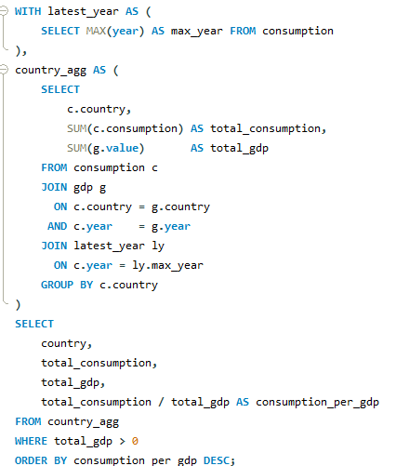
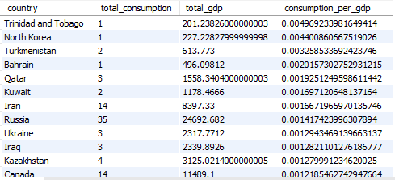
Power Group
13. Which countries have the highest energy consumption relative to GDP?

Slide 20
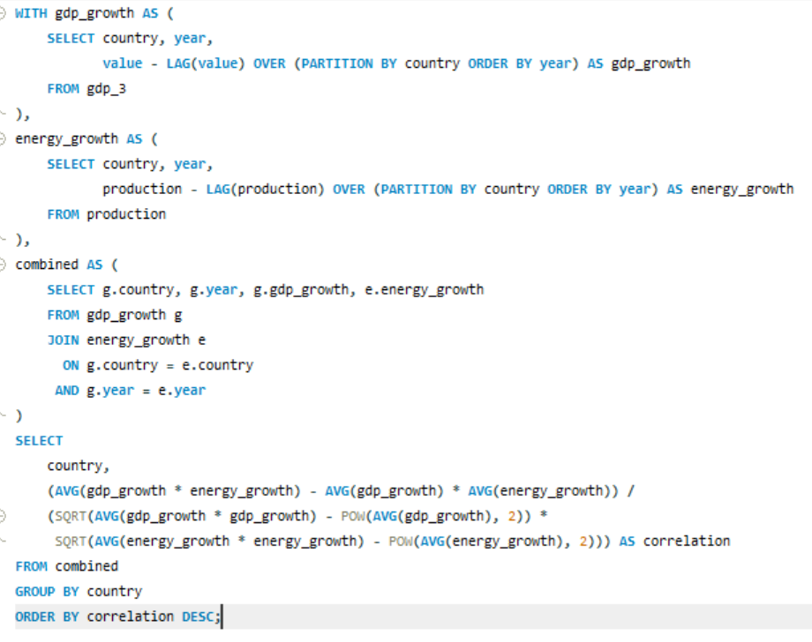

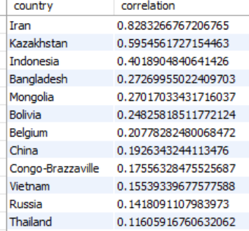
Power Group
14. What is the correlation between GDP growth and energy production growth?

Slide 21
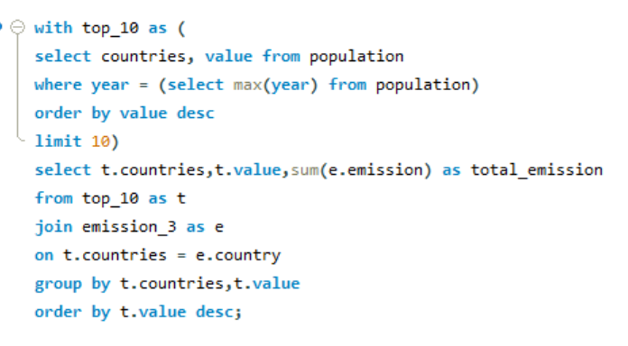
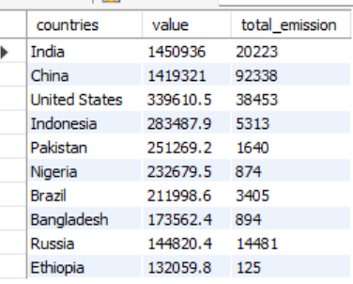

Power Group
Global Comparisons:
15. What are the top 10 countries by population and how do their emissions compare?

Slide 22
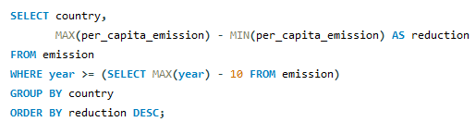
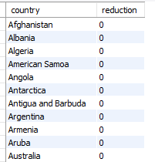

Power Group
16. Which countries have improved (reduced) their per capita emissions the most over the last decade?

Slide 23

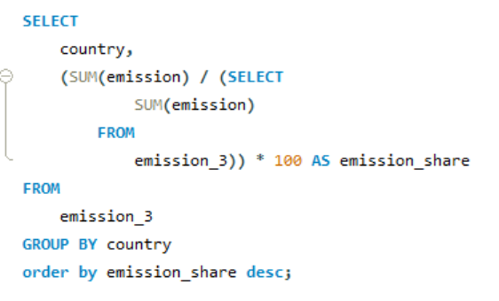
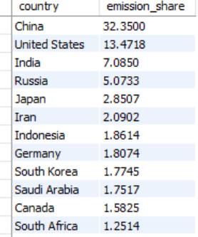
Power Group
17. What is the global share (%) of emissions by country?

Slide 24
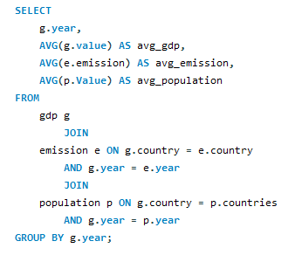
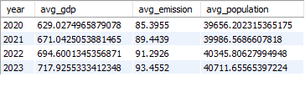
Power Group
18. What is the global average GDP, emission, and population by year?

Slide 25

Power Group
Key Insights
Emissions are highly concentrated, with a small number of countries contributing the majority of global emissions, especially in the most recent year.
Economic growth and energy use are closely linked—countries with higher GDP generally show higher energy production and consumption.
Global emissions and energy consumption have increased over time, driven by population growth and industrial expansion in major economies.
Energy efficiency is improving in some economies, as seen through declining emission-to-GDP ratios and reduced per-capita emissions over the last decade.
GDP growth and energy production growth show a positive correlation, though the strength varies by country, indicating differing levels of energy dependence.

Slide 26

Power Group
Conclusion
This SQL-based analysis shows that global energy consumption and emissions are strongly influenced by economic growth, population size, and energy dependency. While GDP growth is generally associated with higher energy production and emissions, some countries demonstrate improved efficiency through lower emission intensity and per-capita reductions. Overall, the findings highlight the importance of transitioning to cleaner energy sources and improving energy efficiency to achieve sustainable global development.

Slide 27


Power Group
thank
you

